Slide 1
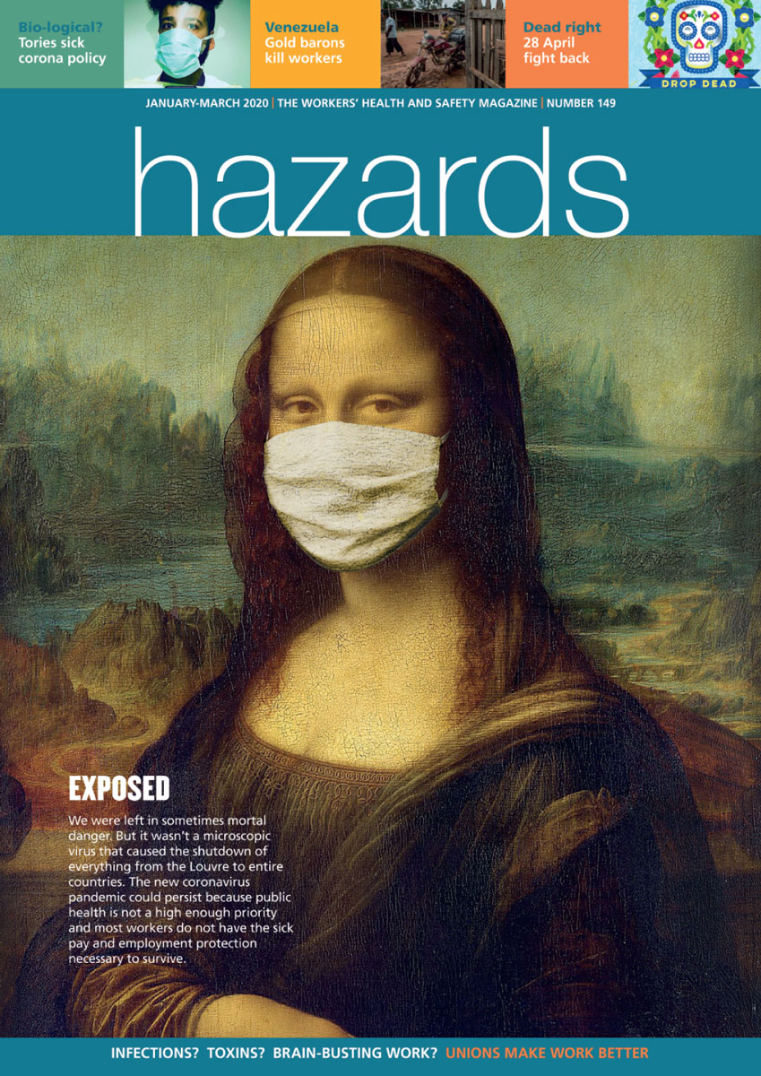
Risk Assessment and Control Hierarchy

Slide 2
What is Risk Assessment?
A systematic approach for controlling risks in the workplace
Legal requirement on employers to risk assess those hazards
Core legislation is the Management of Health and Safety at Work Regulations 1999
https://www.legislation.gov.uk/uksi/1999/3242/regulation/3/made
‘Absolute duty’ – once a significant hazard has been identified, the employer must assess the resultant risk
Other regulations cover specific hazards for example, COSHH, LOLER, DSE, PUWER

Slide 3
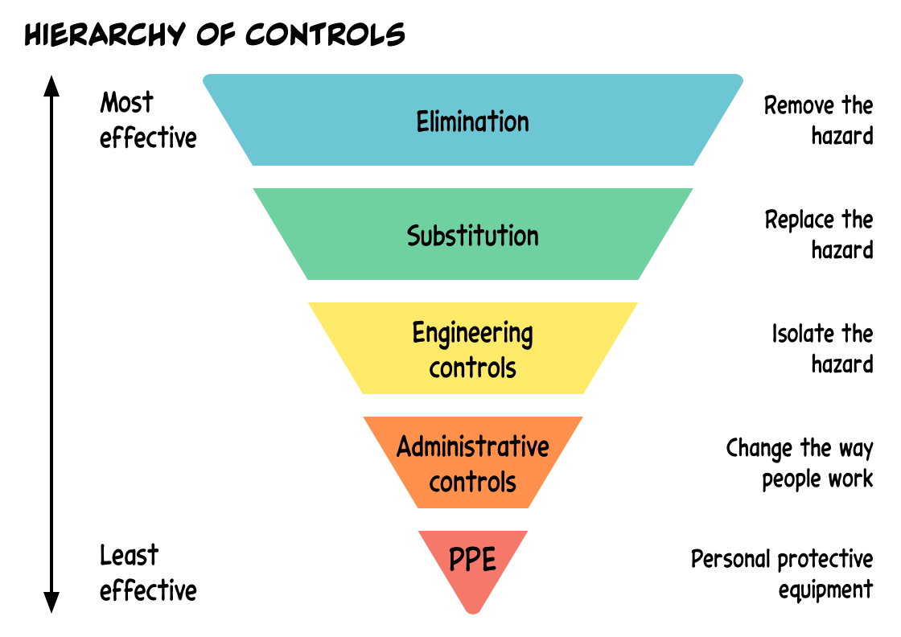
Principles of Prevention
Do we need to be doing what we are doing? If not – Don’t do it!
If we do have to do it, can we do it differently?
If not can we introduce measures to keep people away from the hazard?
If not can we introduce measures to limit exposure or remove distractions etc?
LAST RESORT!
Notes:
1) Elimination Redesign the job or substitute a substance so that the hazard is removed
or eliminated. For example, dutyholders must avoid working at height where
they can.
2) Substitution Replace the material or process with a less hazardous one. For example,
use a small MEWP to access work at height instead of step ladders. Care
should be taken to ensure the alternative is safer than the original.
3) Engineering controls Use work equipment or other measures to prevent falls where you cannot
avoid working at height. Install or use additional machinery such as local
exhaust ventilation to control risks from dust or fume. Separate the hazard
from operators by methods such as enclosing or guarding dangerous items
of machinery/equipment. Give priority to measures which protect
collectively over individual measures.
4) Administrative controls These are all about identifying and implementing the procedures you need
to work safely. For example: reducing the time workers are exposed to
hazards (eg by job rotation); prohibiting use of mobile phones in hazardous
areas; increasing safety signage, and performing risk assessments.
5) Personal protective
clothes and equipment
Only after all the previous measures have been tried and found ineffective in
controlling risks to a reasonably practicable level, must personal protective
equipment (PPE) be used. For example, where you cannot eliminate the
risk of a fall, use work equipment or other measures to minimise the
distance and consequences of a fall (should one occur). If chosen, PPE
should be selected and fitted by the person who uses it. Workers must be
trained in the function and limitation of each item of PPE

Slide 4
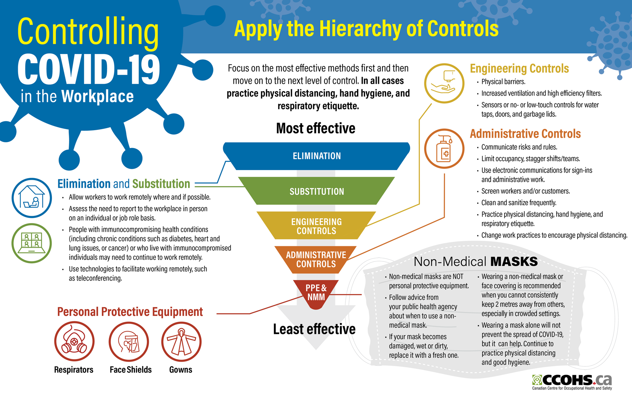
Hierchy of Controls

Slide 5
Layered approach to controlling the risks

Slide 6
Individual Risk Assessments
Regulations require that employers do specific assessments for:
Young workers
New/expectant mothers
Disabled workers
Covid: Consider additional vulnerable workers

Slide 7
Rights of safety reps
Employers have a legal duty to consult with Safety Reps on anything affecting their members’ safety. This would include the outcomes of any risk assessment. SRSC Regulation 7
Safety reps also have the right to conduct their own workplace inspections, including documentation such as risk assessments. SRSC regulations 5 and 7
It is good practice in the current situation for employers and trade unions to jointly conduct workplace inspections, and agree the outcomes of any risk assessments.
Employers must also consult with safety reps on introduction (or planning of) any new technology (such as testing for COVID-19). SRSC regulation 7

